Slide 1
The Coding School’s 2020 Quantum Computing Summer Camp
Hands-on learning
Day 1: Intro to Boolean logic and classical circuits

Slide 2
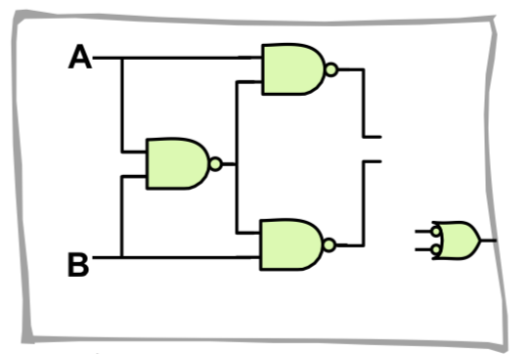
Basic gates repertoire

Slide 3
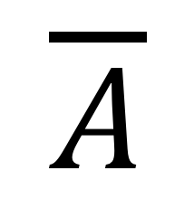
NOT gate
(1 input gate)
$$\overline{A}$$
Truth table
IN | OUT
0 | 1
1 | 0

Slide 4
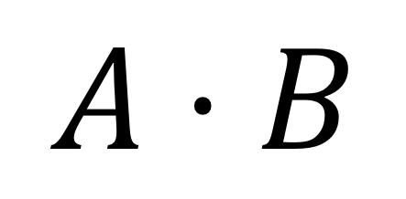
AND gate
$$A⋅B$$
Truth table
IN 1 | IN 2 | OUT
0 | 0 | 0
0 | 1 | 0
1 | 0 | 0
1 | 1 | 1

Slide 5
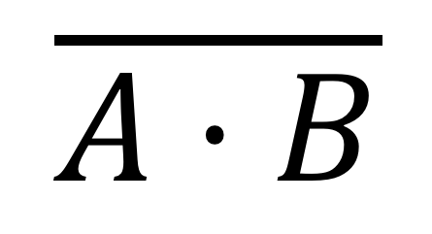
NAND gate
$$\overline{A⋅B}$$
IN 1 | IN 2 | OUT
0 | 0 | 1
0 | 1 | 1
1 | 0 | 1
1 | 1 | 0
=

Slide 6
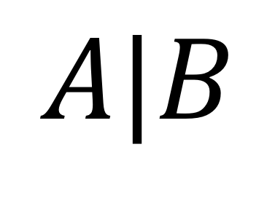
OR gate
$$A|B$$
IN 1 | IN 2 | OUT
0 | 0 | 0
0 | 1 | 1
1 | 0 | 1
1 | 1 | 1

Slide 7
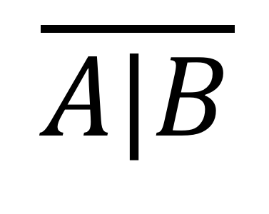
NOR gate
$$\overline{A|B}$$
IN 1 | IN 2 | OUT
0 | 0 | 1
0 | 1 | 0
1 | 0 | 0
1 | 1 | 0
=

Slide 8
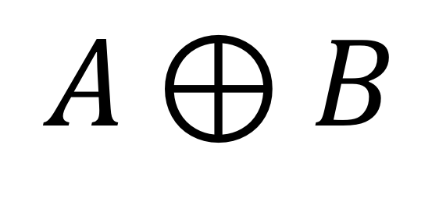
XOR gate
(Exclusive OR gate)
$$A⊕B$$
IN 1 | IN 2 | OUT
0 | 0 | 0
0 | 1 | 1
1 | 0 | 1
1 | 1 | 0

Slide 9
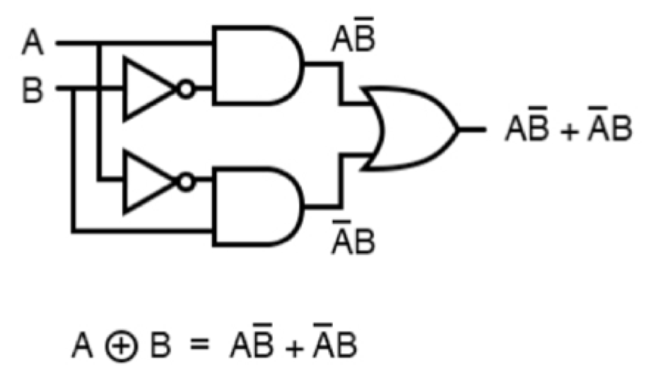
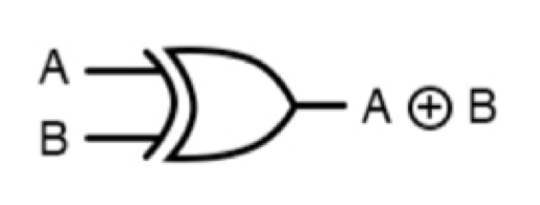
XOR gate
(Exclusive OR gate)
=
Is equivalent to…

Slide 10
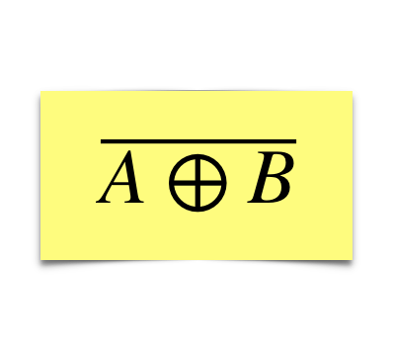
XNOR gate
IN 1 | IN 2 | OUT
0 | 0 | 1
0 | 1 | 0
1 | 0 | 0
1 | 1 | 1
=

Slide 11
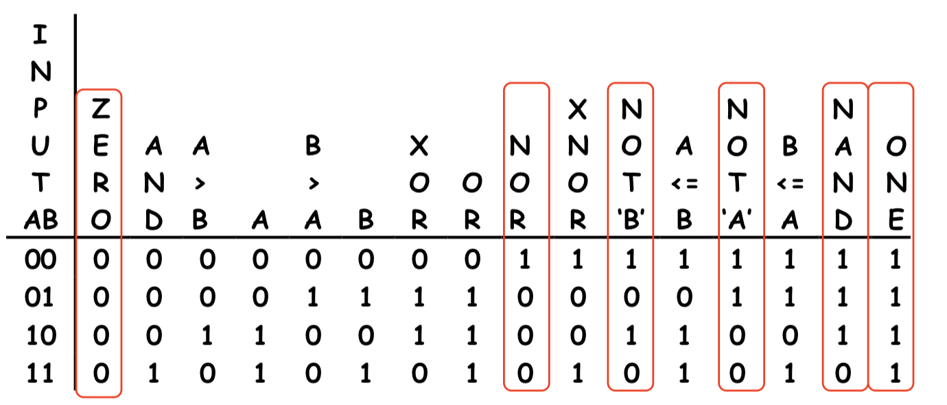
Exercise: There are only so many gates…
Write down all possible combinations for 2-input 1-output gates and select those we already know.

Slide 12
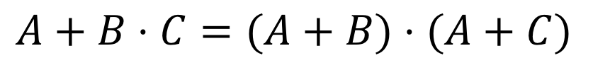
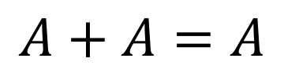
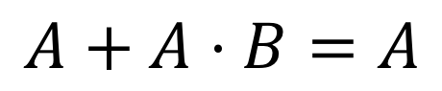
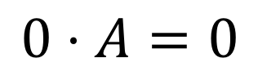
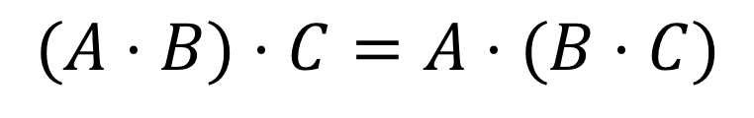
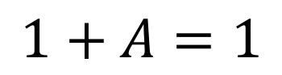
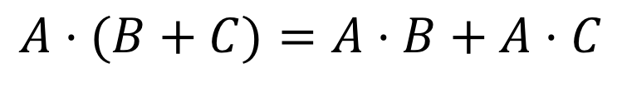
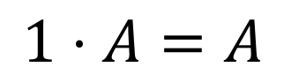
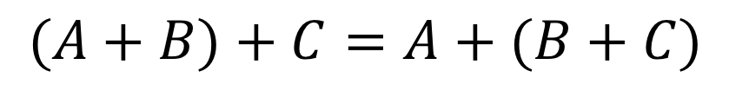
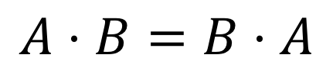
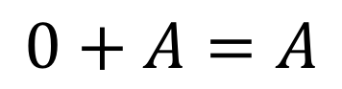
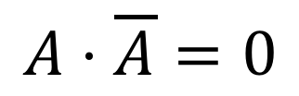
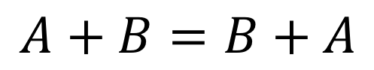
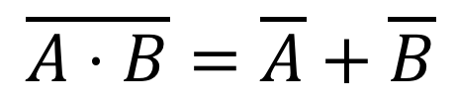
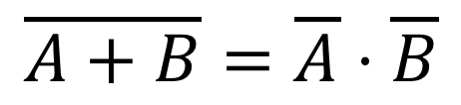
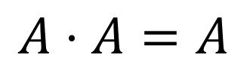
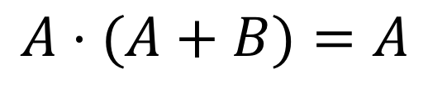
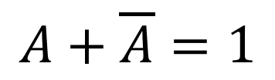
Boolean Algebra Rules
Name | AND form | OR form
Identity law
Null law
Idempotent law
Inverse law
Commutative law
Associative law
Distributive law
Absorption law
De Morgan’s law
$$1⋅A=A$$
$$0+A=A$$
$$0⋅A=0$$
$$1+A=1$$
$$A⋅A=A$$
$$A+A=A$$
$$A⋅\overline{A}=0$$
$$A+\overline{A}=1$$
$$A⋅B=B⋅A$$
$$A+B=B+A$$
$$(A⋅B)⋅C=A⋅(B⋅C)$$
$$(A+B)+C=A+(B+C)$$
$$A+B⋅C=(A+B)⋅(A+C)$$
$$A⋅(B+C)=A⋅B+A⋅C$$
$$A⋅(A+B)=A$$
$$A+A⋅B=A$$
$$\overline{A⋅B}=\overline{A}+\overline{B}$$
$$\overline{A+B}=\overline{A}⋅\overline{B}$$

Slide 13
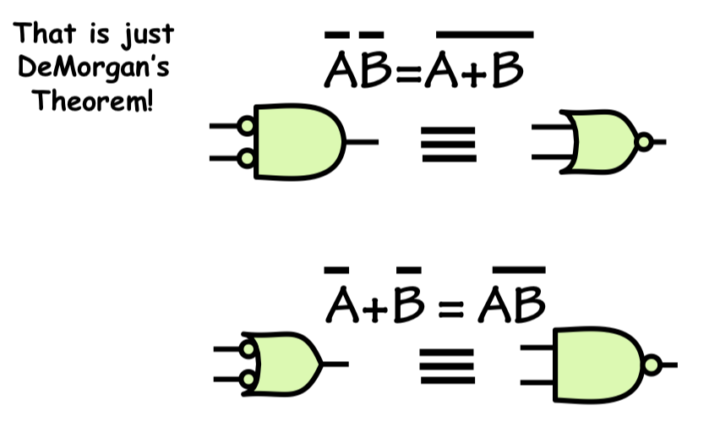
De Morgan’s Theorem

Slide 14
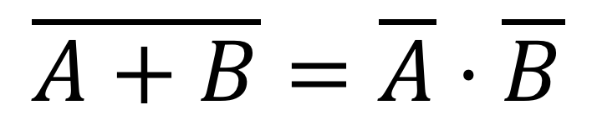
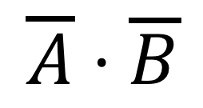
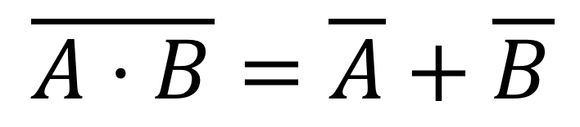
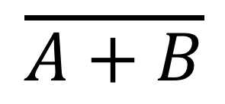
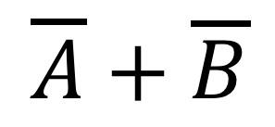
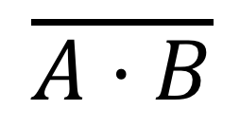
De Morgan’s Laws
In class exercise: (Truth table verification)
$$\overline{A⋅B}=\overline{A}+\overline{B}$$
$$\overline{A+B}=\overline{A}⋅\overline{B}$$
A | B
0 | 0 | 1 | 1
0 | 1 | 1 | 1
1 | 0 | 1 | 1
1 | 1 | 0 | 0
A | B
0 | 0 | 1 | 1
0 | 1 | 0 | 0
1 | 0 | 0 | 0
1 | 1 | 0 | 0
$$\overline{A⋅B}$$
$$\overline{A}+\overline{B}$$
$$\overline{A+B}$$
$$\overline{A}⋅\overline{B}$$

Slide 15
Synthesis of Combinational Logic

Slide 16
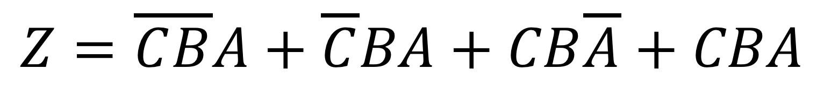
Functional specifications
There are many ways of specifying the function of a combinational device
Truth table
If C is 1 then copy B to Z, otherwise copy A to Z
C | B | A | Z
0 | 0 | 0 | 0
0 | 0 | 1 | 1
0 | 1 | 0 | 0
0 | 1 | 1 | 1
1 | 0 | 0 | 0
1 | 0 | 1 | 0
1 | 1 | 0 | 1
1 | 1 | 1 | 1
A
B
Z
C
$$Z=\overline{C}\overline{B}A+\overline{C}BA+CB\overline{A}+CBA$$
Truth tables: Concise description of the combinatorial system’s function
Boolean expressions: form an algebra whose operations are AND, OR and NOT.
Any combinational function can be specified as a truth table or an equivalent Boolean expression in terms of sum of products

Slide 17
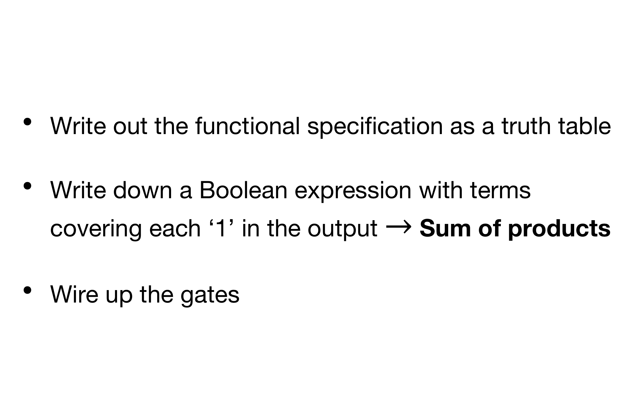
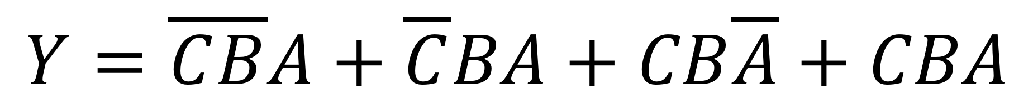
A design approach
Truth table
C | B | A | X
0 | 0 | 0 | 0
0 | 0 | 1 | 1
0 | 1 | 0 | 0
0 | 1 | 1 | 1
1 | 0 | 0 | 0
1 | 0 | 1 | 0
1 | 1 | 0 | 1
1 | 1 | 1 | 1
Write out the functional specification as a truth table
Write down a Boolean expression with terms covering each ‘1’ in the output $→$ Sum of products
Wire up the gates
$$Y=\overline{C}\overline{B}A+\overline{C}BA+CB\overline{A}+CBA$$

Slide 18


In class-exercise:
Binary adder
Design a logic circuit to compute the sum of two 1-bit bits. Have one bit (S) to output the 1-bit result and a carry-out bit (C) for the carry of the sum.
A
Binary Adder
$$Σ$$
A | B | Sum ( ) | Carry out (C)
0 | 0 | 0 | 0
0 | 1 | 1 | 0
1 | 0 | 1 | 0
1 | 1 | 0 | 1
$$Σ$$
B
C
Block diagram

Slide 19
In class-exercise
Adding two binary numbers
Solution
Sum
Carry

Slide 20
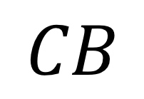
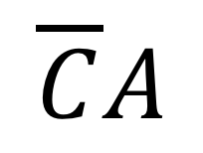
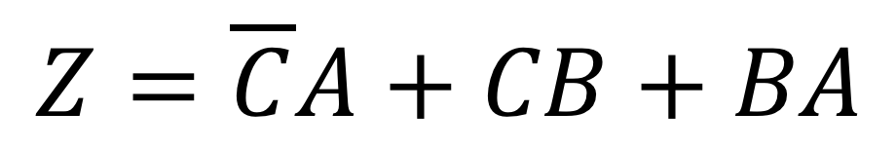
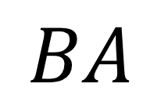
Truth tables with “Don’t Cares”
We use an “X” or “don’t cares” to indicate that the value of a particular input is irrelevant in determining then value of the output.
C | B | A | Z
0 | 0 | 0 | 0
0 | 0 | 1 | 1
0 | 1 | 0 | 0
0 | 1 | 1 | 1
1 | 0 | 0 | 0
1 | 0 | 1 | 0
1 | 1 | 0 | 1
1 | 1 | 1 | 1
C | B | A | Z
0 | X | 0 | 0
0 | X | 1 | 1
1 | 0 | X | 0
1 | 1 | X | 1
X | 0 | 0 | 0
X | 1 | 1 | 1
$$\overline{C}A$$
$$CB$$
$$Z=\overline{C}A+CB+BA$$
$$BA$$

Slide 21
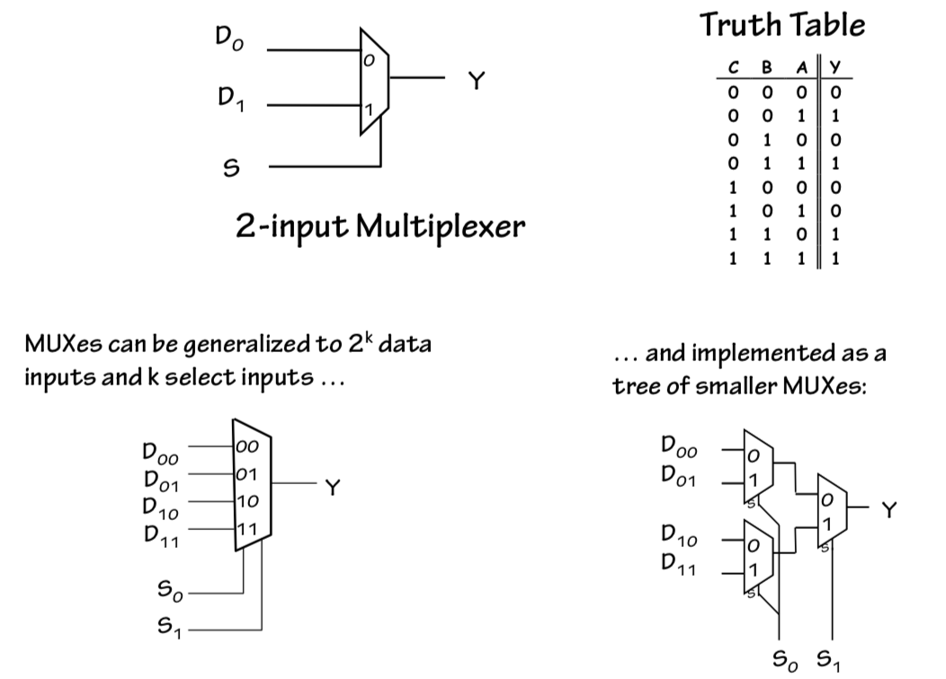
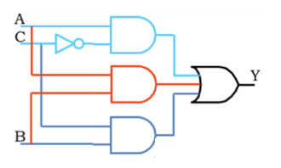
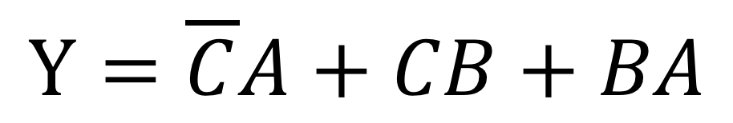
Designing a 2-input multiplexer
A multiplexer is a combinational logic circuit designed to switch one of the input lines through to a single common output line by the application of a control signal.
C | B | A | Y
0 | X | 0 | 0
0 | X | 1 | 1
1 | 0 | X | 0
1 | 1 | X | 1
X | 0 | 0 | 0
X | 1 | 1 | 1
$$Y=\overline{C}A+CB+BA$$

Slide 22
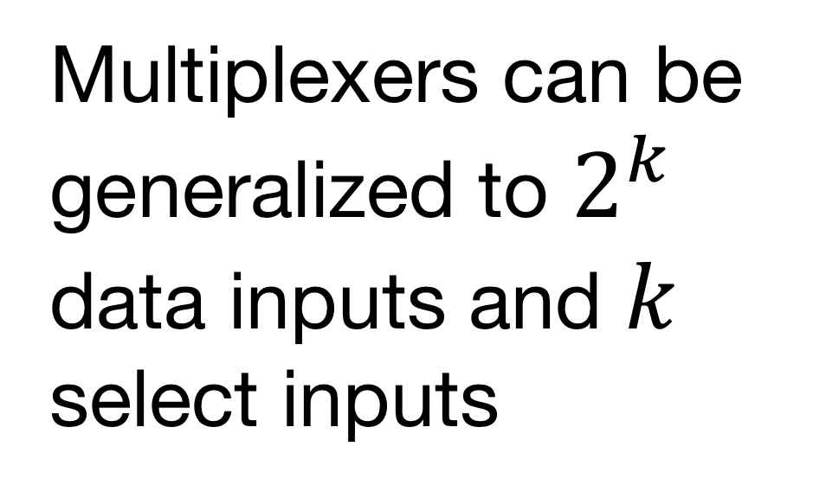
Multiplexers can be generalized to more data inputs inputs…
Also implemented as a tree of smaller multiplexers
Multiplexers can be generalized to $2^{k}$ data inputs and $k$ select inputs

Slide 23
Lab: 4-input multiplexer
Design a multiplexer that switches one of the 4 input lines through a single output line using 2 lector bits.
X | Y | A | B | C | D | Q
0 | 0 | 1 | x | x | x | 1
0 | 1 | x | 1 | x | x | 1
1 | 0 | x | x | 1 | x | 1
1 | 1 | x | x | x | 1 | 1

Slide 24
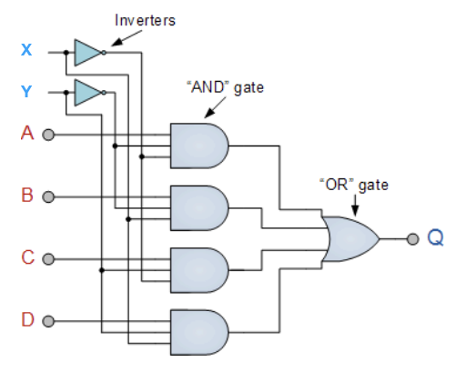
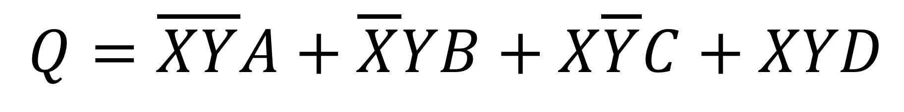
Solution:
X | Y | A | B | C | D | Q
0 | 0 | 1 | x | x | x | 1
0 | 1 | x | 1 | x | x | 1
1 | 0 | x | x | 1 | x | 1
1 | 1 | x | x | x | 1 | 1
$$Q=\overline{X}\overline{Y}A+\overline{X}YB+X\overline{Y}C+XYD$$

